Slide 1
ENSF 607 Lab 4
Nick Nikolov
Andrew Lee
Tahmid Kazi
Romil Dhagat​

Slide 2
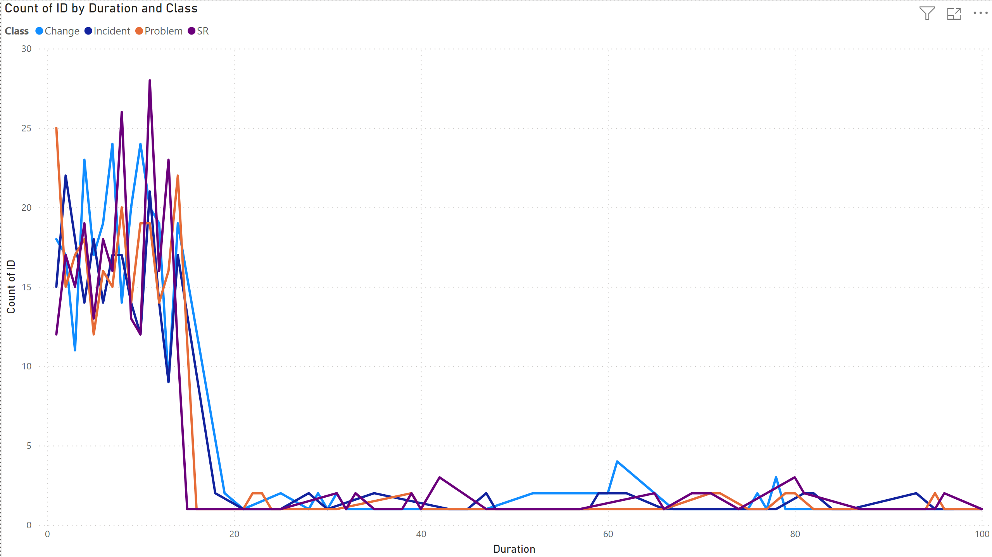
# of tickets by duration and class
X-axis : Duration
Y-Axis : Tickets
Lines designate class
Key takeaway:
As duration increases the number of tickets get lower as they are being taken completed
Most service tickets have a duration of below 20 days

Slide 3
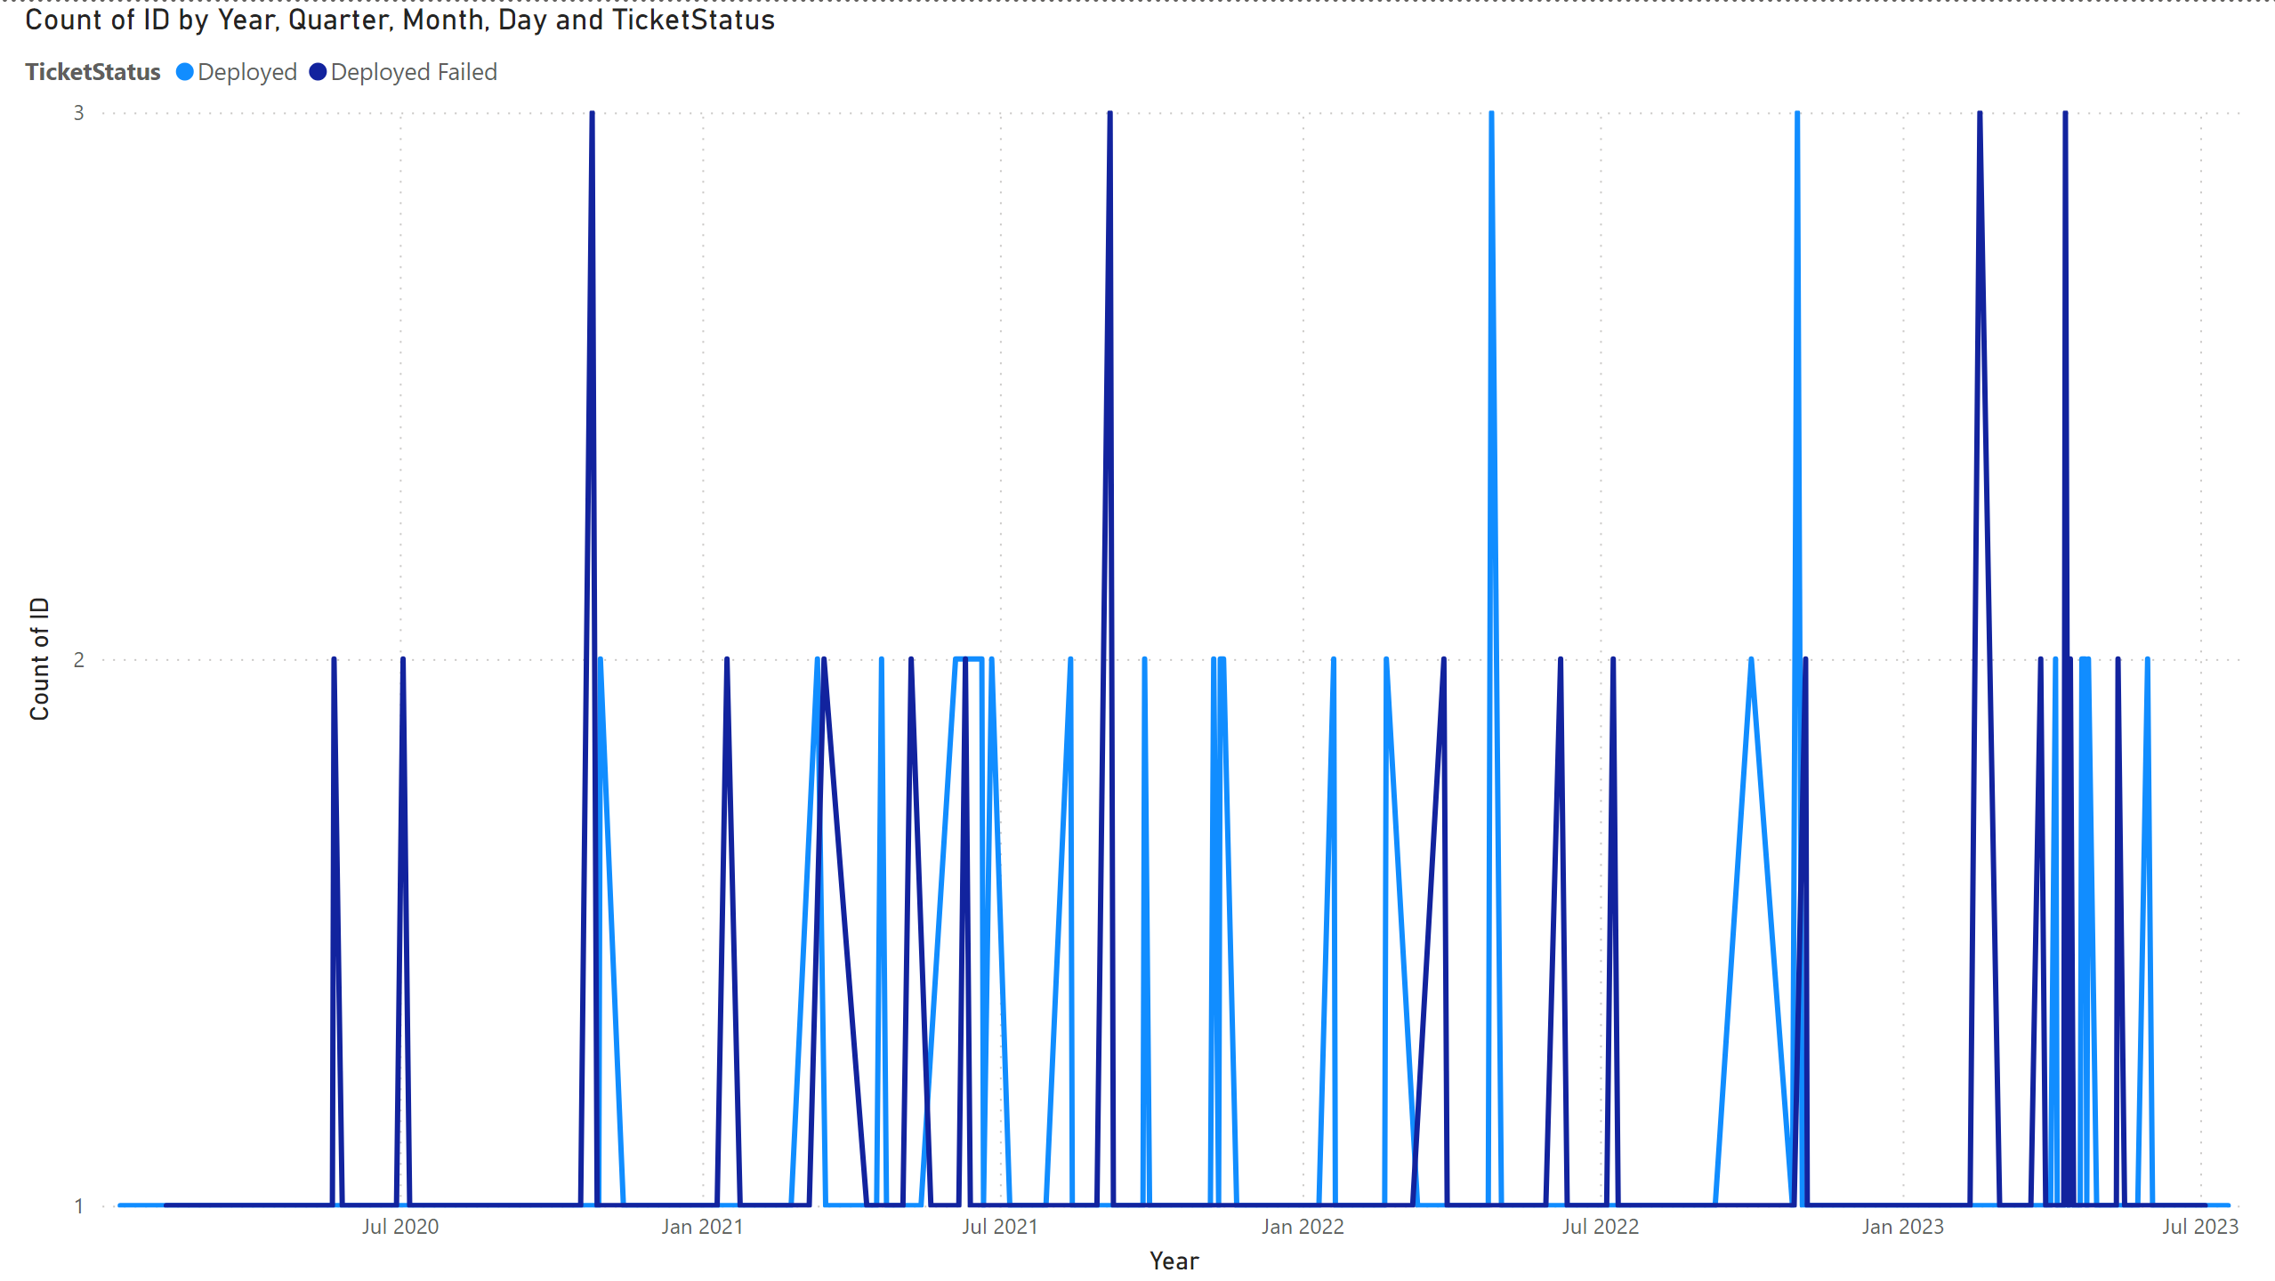
# of tickets by Enddate and Ticket Status
X-Axis : End date by month
Y-Axis : Number of tickets, that were deployed or deployed failed
Key takeaway:
More service tickets deployed failed before they were successfully deployed

Slide 4
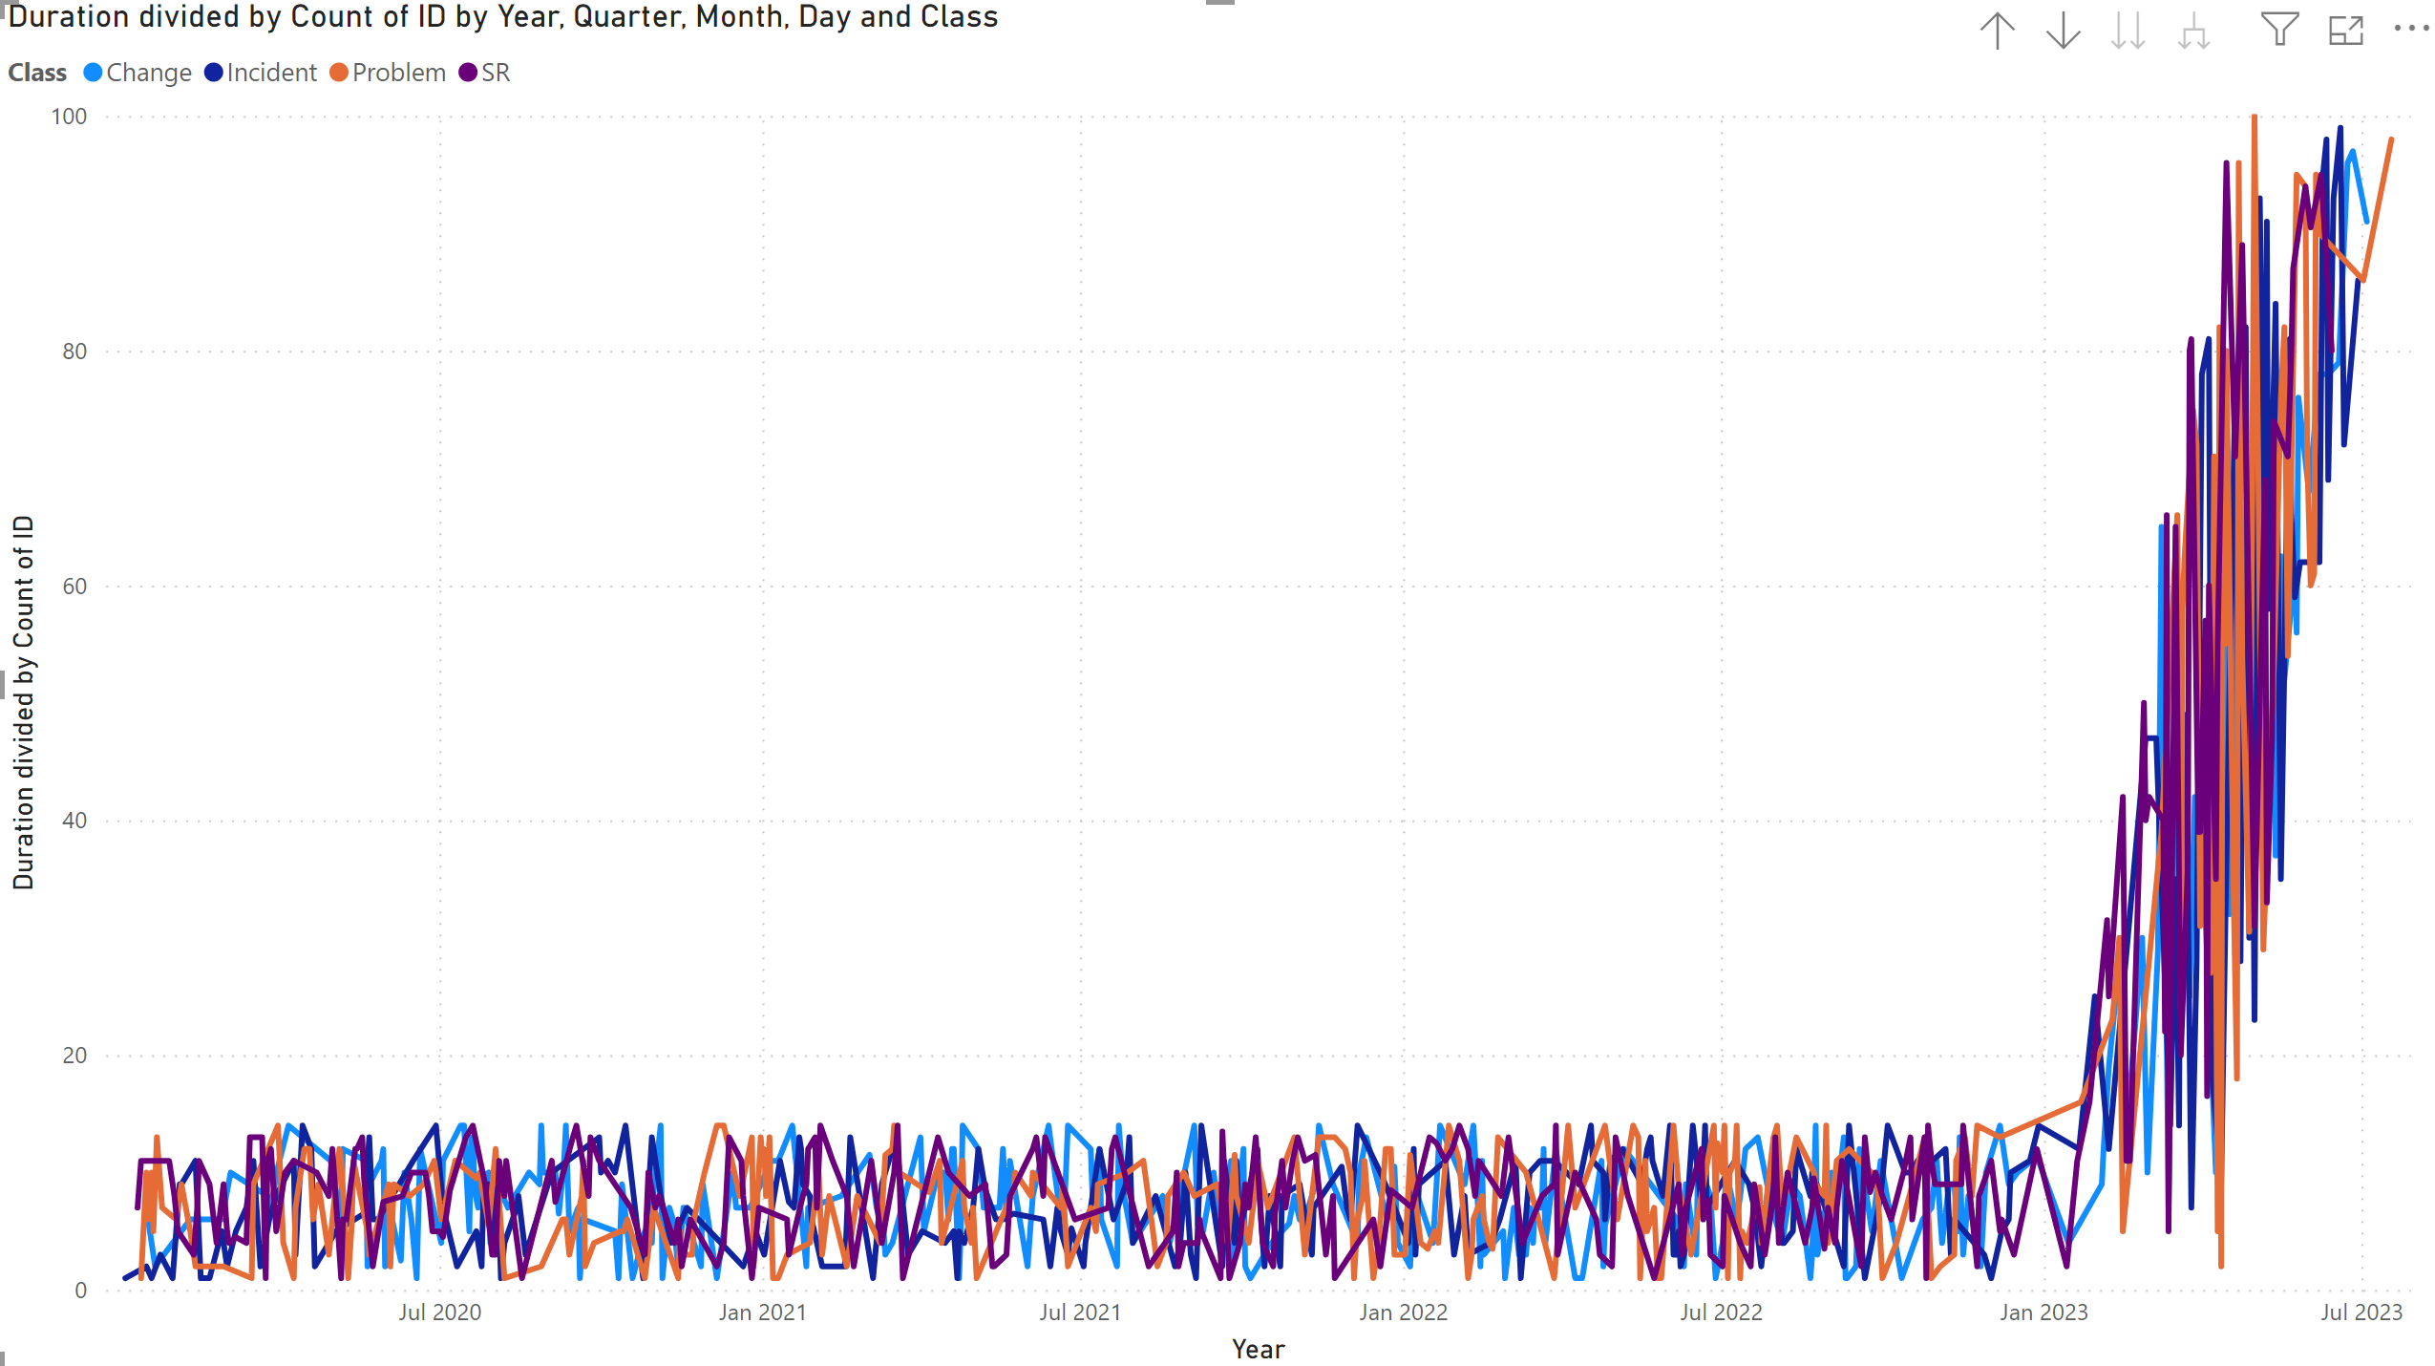
MTTR by EndDate
X-Axis : Time
Y-Axis : MTTR, separated by class
Key takeaway:
MTTR increases as we reduce the number of tickets, that is why we see a spike towards the end.

Slide 5
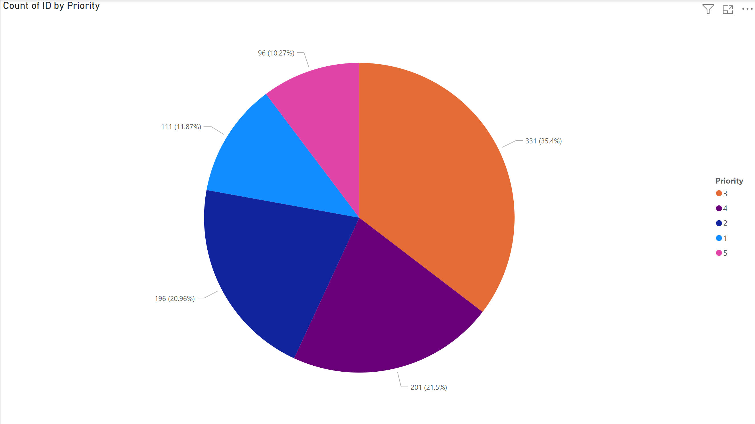
Pie chart
This pie chart depicts the numbers of tickets and what priority they were given.
We can see most tickets were priority level 3 and priority lever M has the least number of tickets

Slide 6
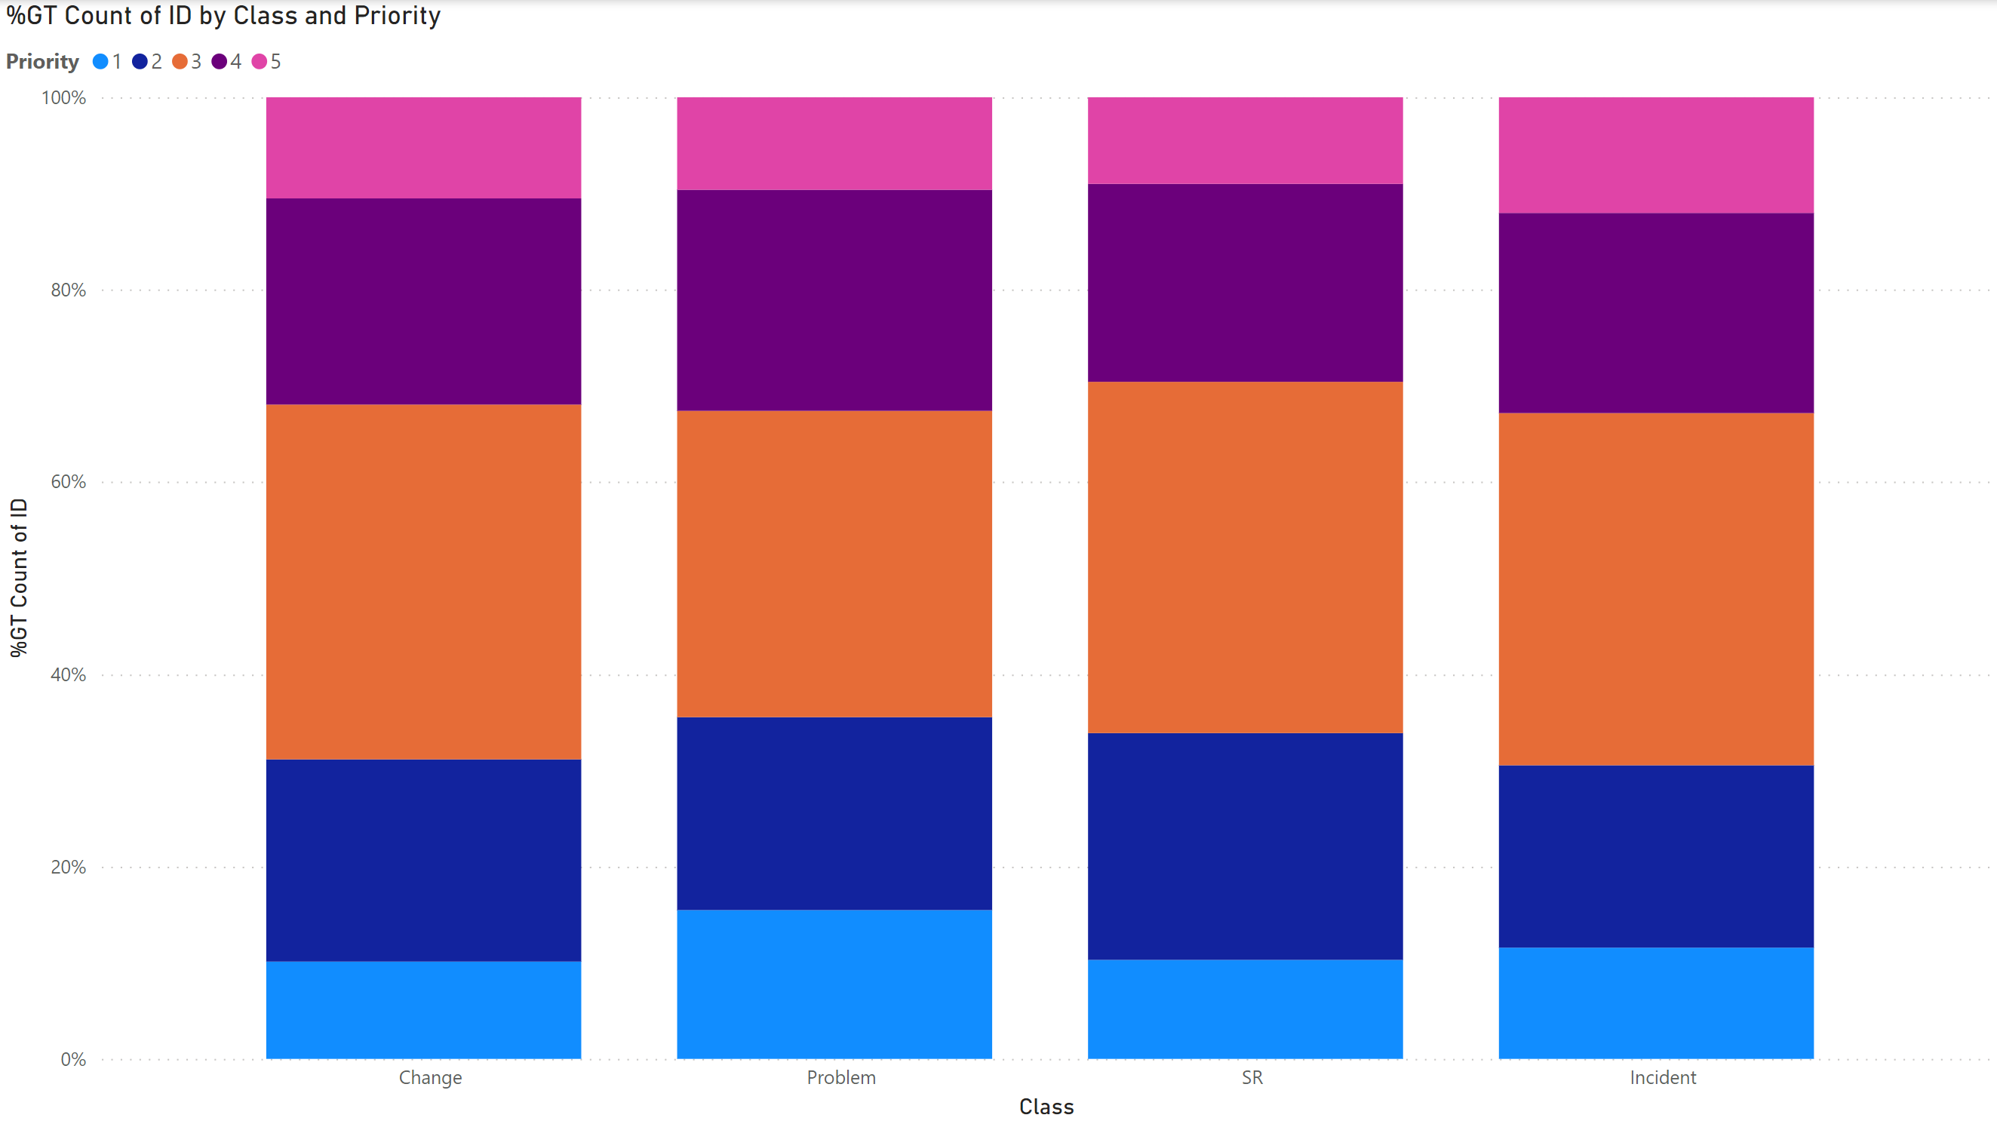
Bar Chart
X-Axis : Class
Y-Axis : Priority % of tickets
From this dashboard we can see that the classes has a mostly even split of priorities per class.

Slide 7
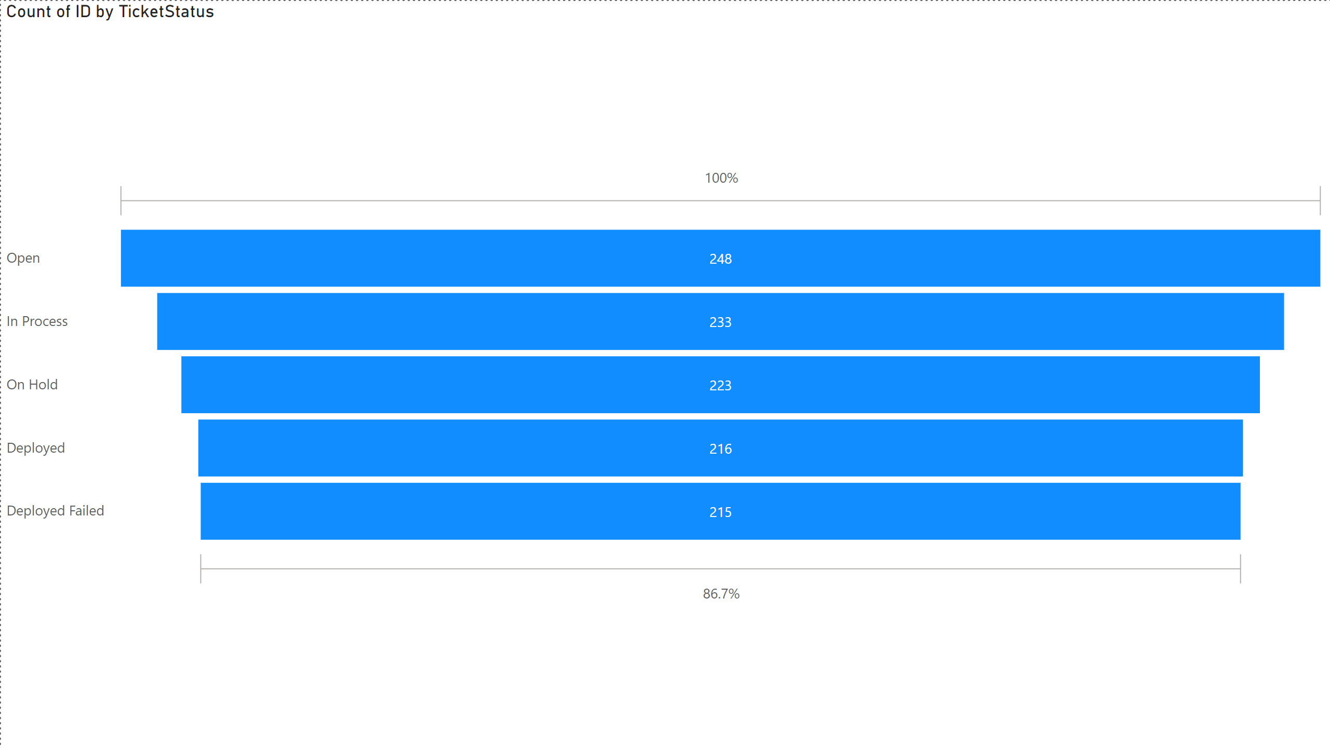
Count of id by ticket status
This graph shows the split of tickets and the status they were.

